Slide 1
Product Summary

Slide 2
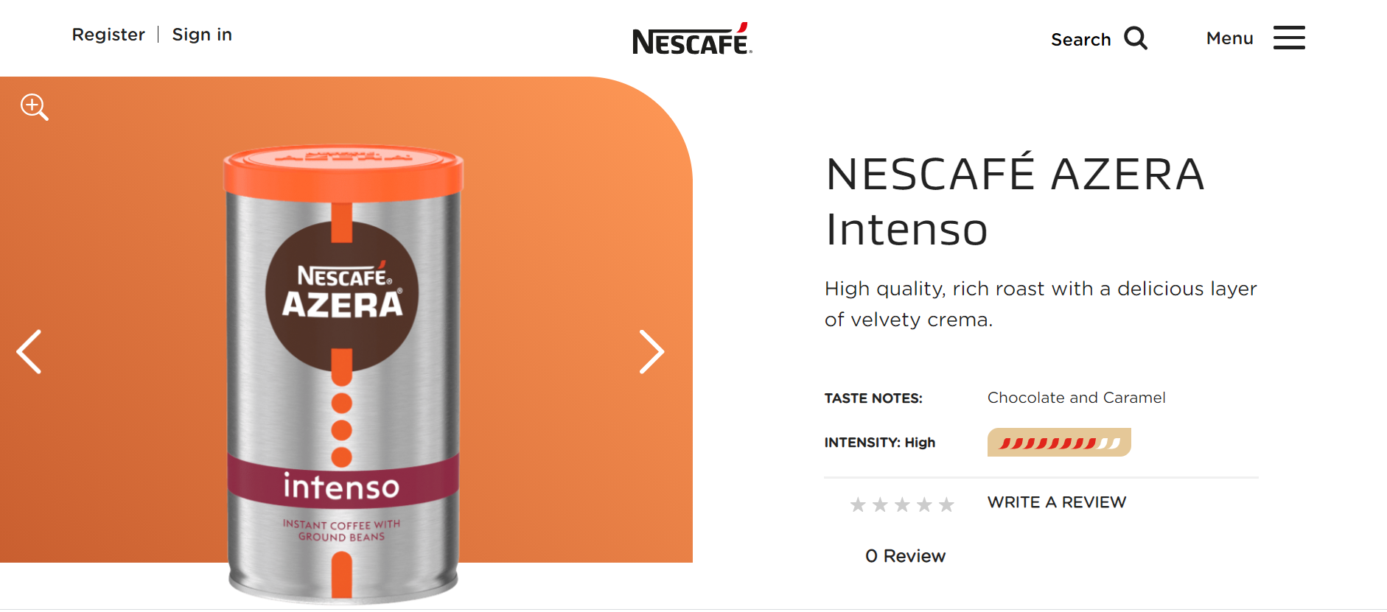
Image 1
Buy now for me appears above the fold the fold (eventually because of screen resolution?)–
its mandatory to be above the fold – both in mobile and in desktop.
Can be smaller? Looks to big in desktop and mobile.

Slide 3
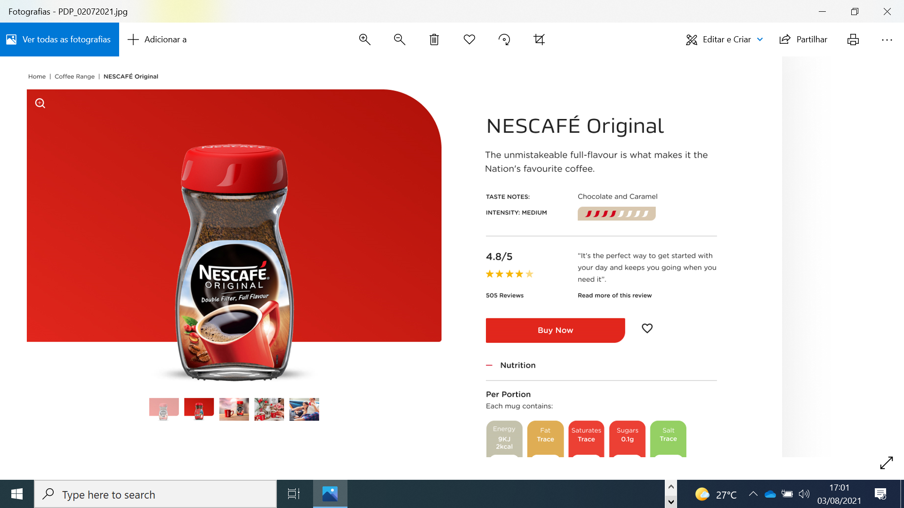
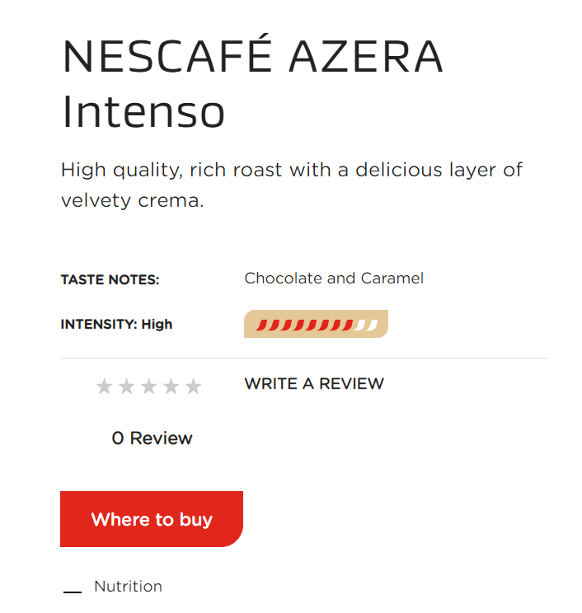
Image 1
Should be done with current R&R being migrated now?
Miss read review option – as per design – and aggregated score

Slide 4
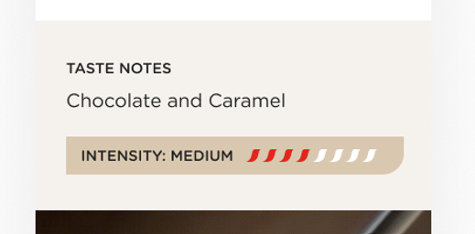
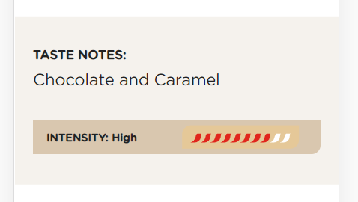
Image 1
design
UAT
Colors are different.

Slide 5
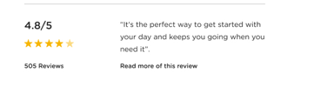

Slide 6
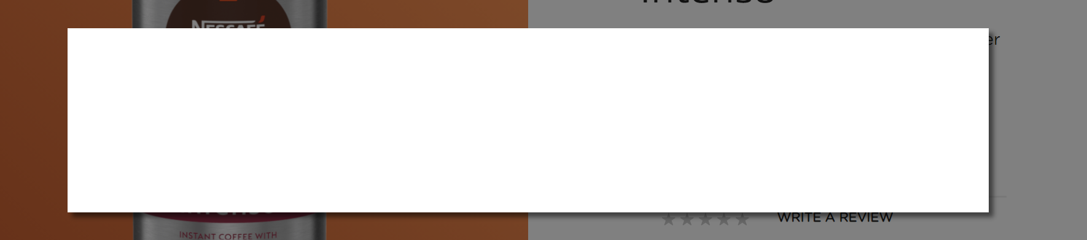
Image 1
How is the exploration of this feature? As UAT was delay 1 week should be covered.
Buy Now Integration can’t be tested.
It considers 2nd button – geolocation that some countries have?

Slide 7



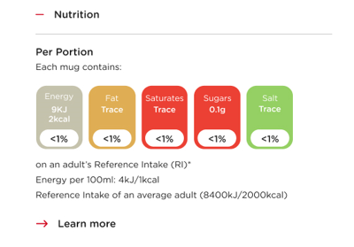
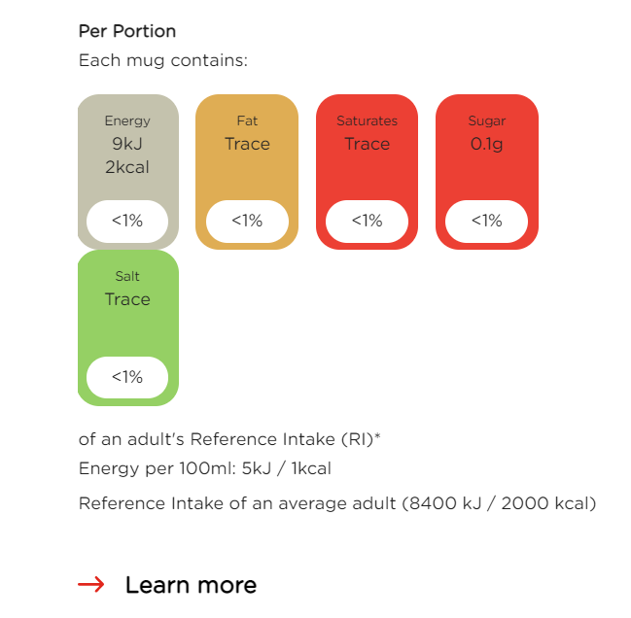
design
UAT

Slide 8
Zoom

Slide 9
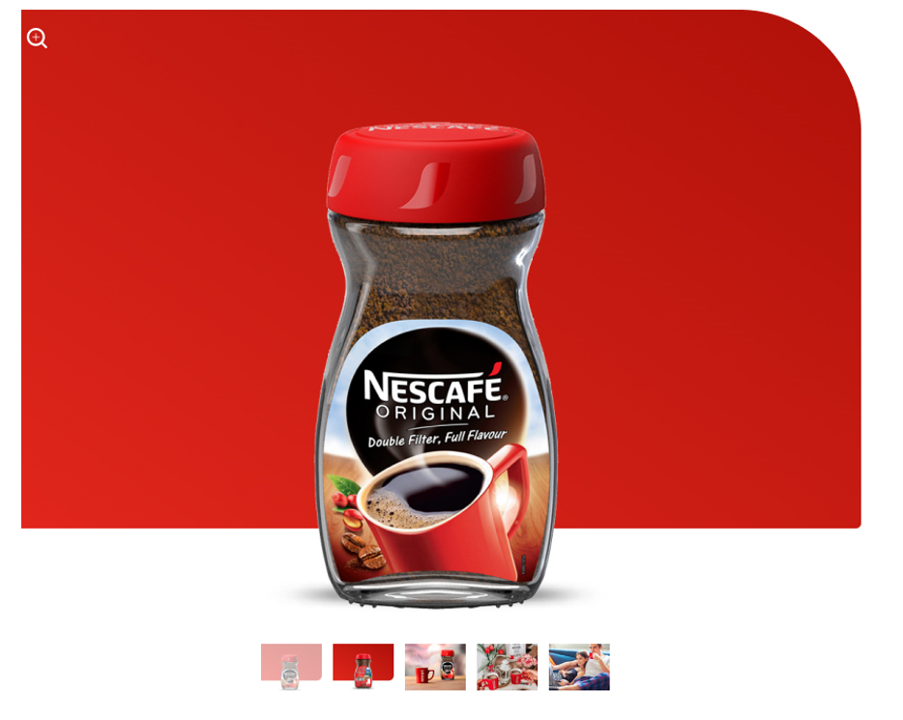
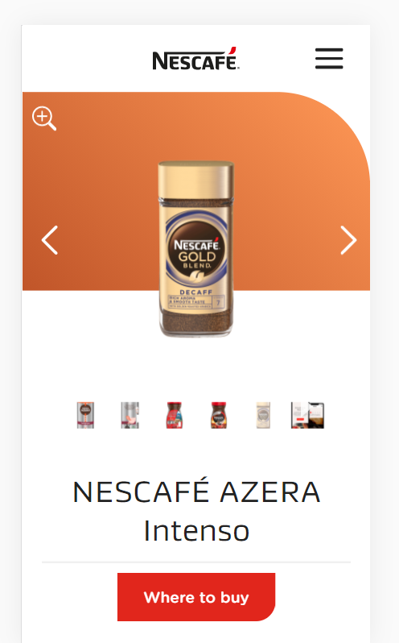
Image 3
Could the zoom icon be smaller – as per design?

Slide 10
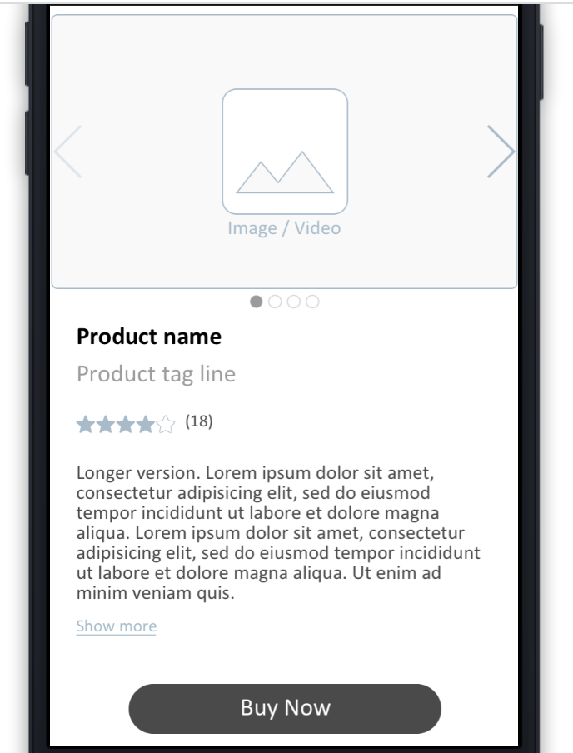
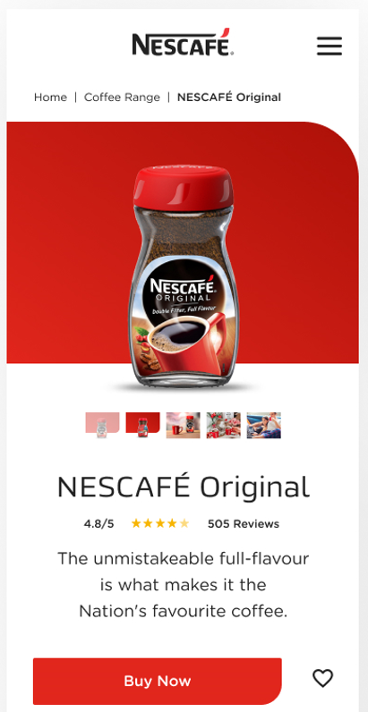
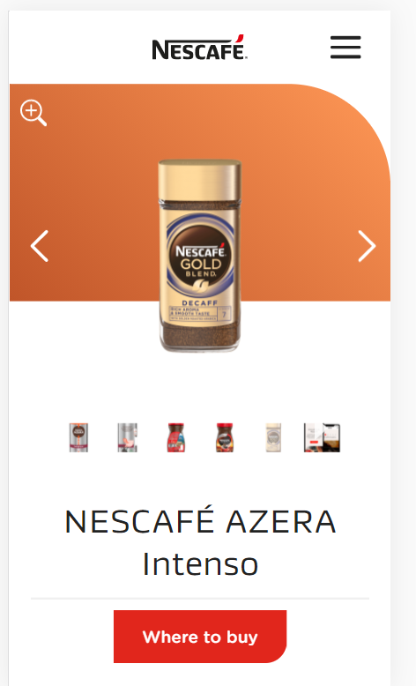
Image
Lightnest wireframe
Design
Now
Mobile has to be reviewed to follow above the fold reccomendations.

Slide 11
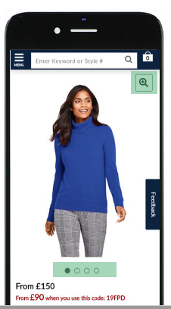
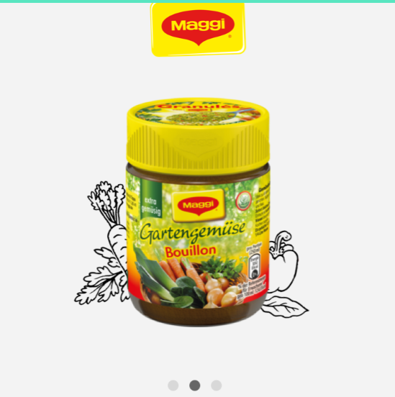
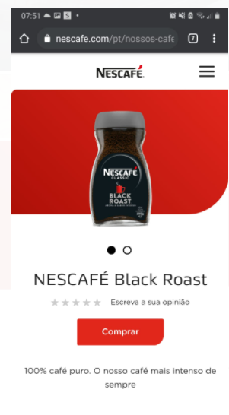
Image 3
Previous template – follows reccomendations
Do we need to change image navigation for circles?

Slide 12
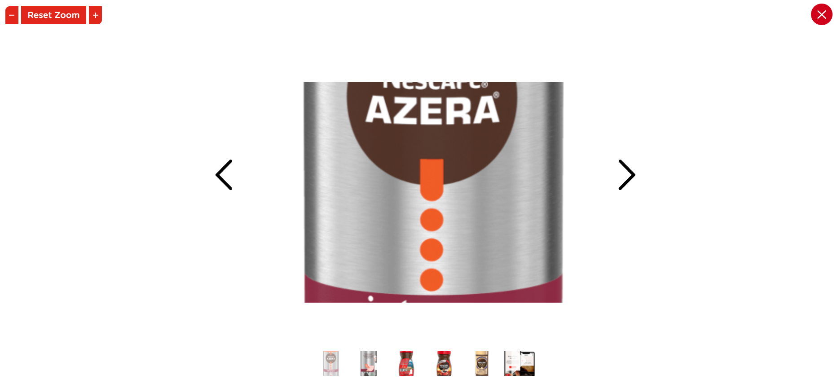
Image 3
Not the common approach in terms of UX. The common approach – magnifying glass and reduce again with the mouse.
Limitation of zoom in – 1 click zoom. No need for zoom out below the real size.
References:
laredoute.com
zara.com

Slide 13
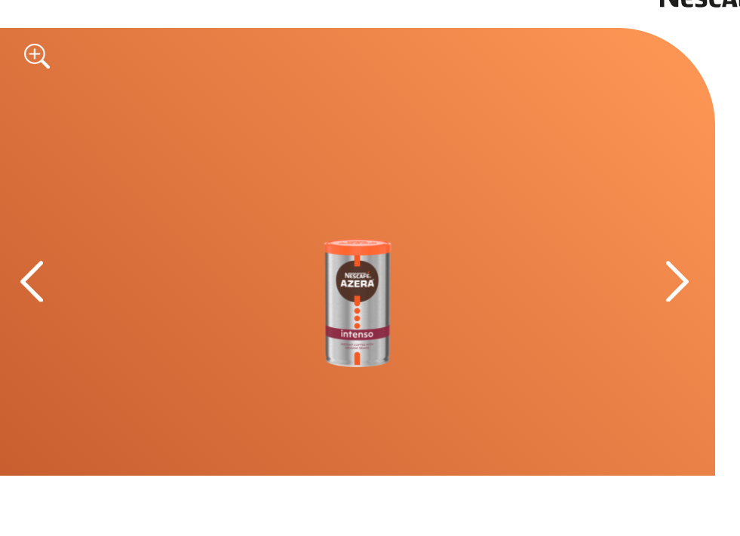
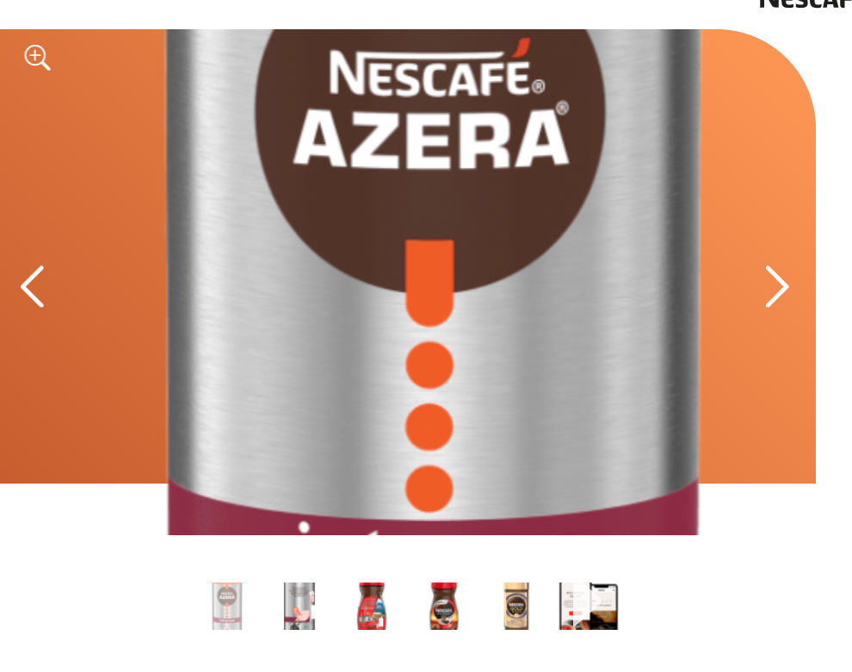
Image 3
After doing zoom – if we don’t reset zoom and close the zoom option the image stays in the same size as per the zoom - this is not the normal behaviour of the zoom feature.

Slide 14
Videos

Slide 15
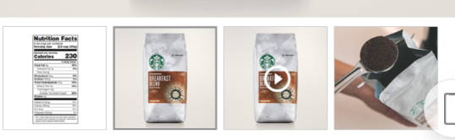
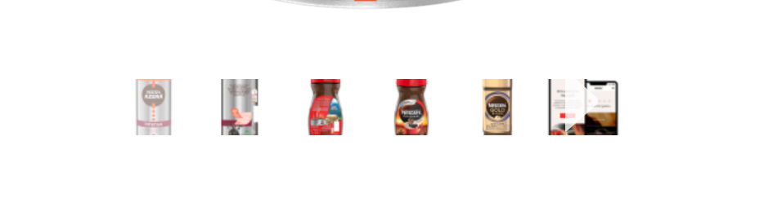

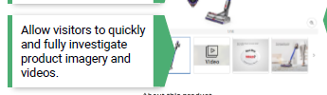
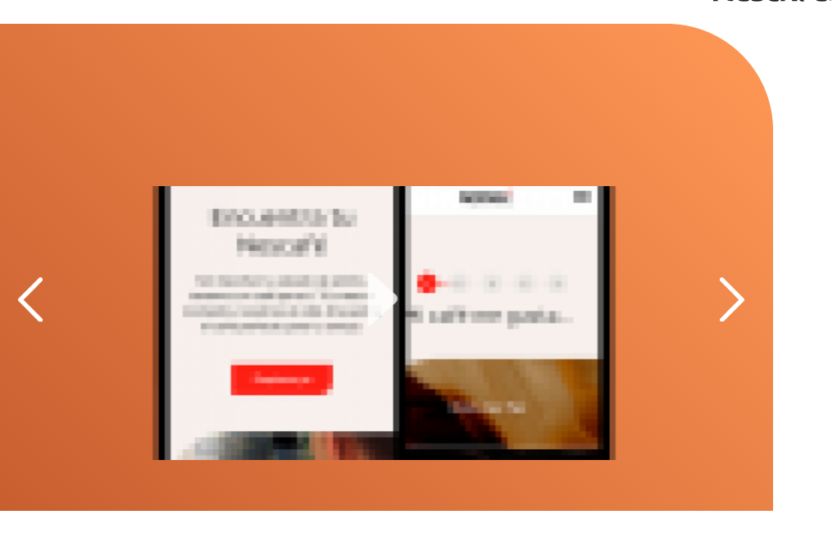
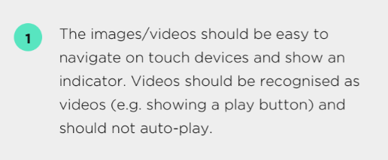
Image 3
We need to see a video working.

Slide 16
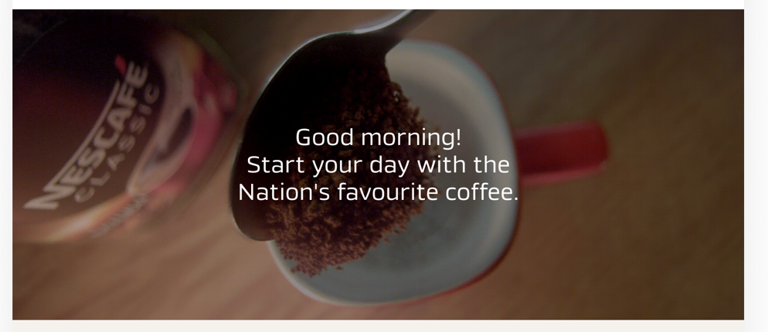
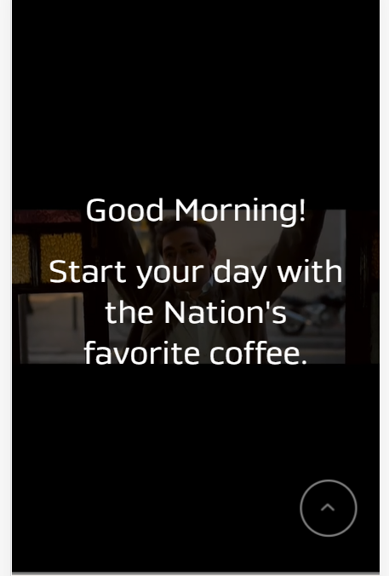

design
UAT
It has a black backgournd – not working as per design, doesn’t look good
Should stop when scrolling down to the coffee facts module, right? but only stops after that
Note – it does not have the title option for the module that we asked for last week (tittla should be optional)

Slide 17
Additional modules

Slide 18
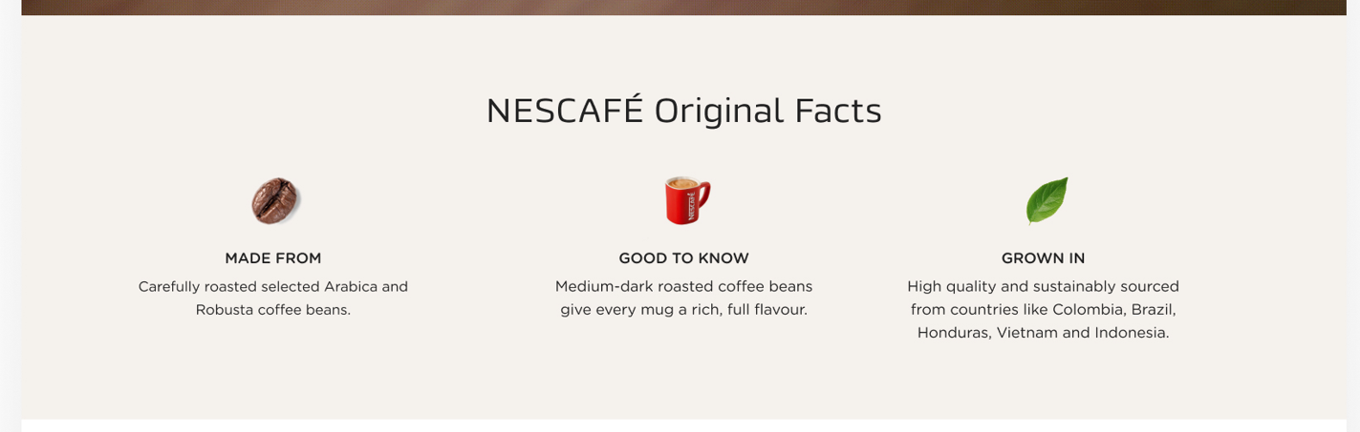
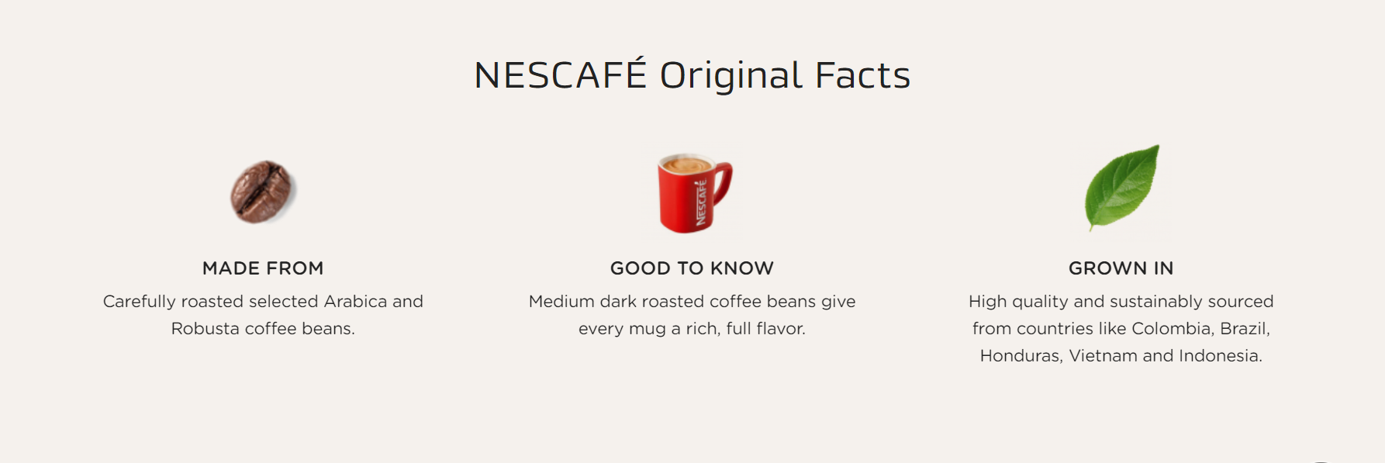
design
UAT
Much Bigger icons

Slide 19
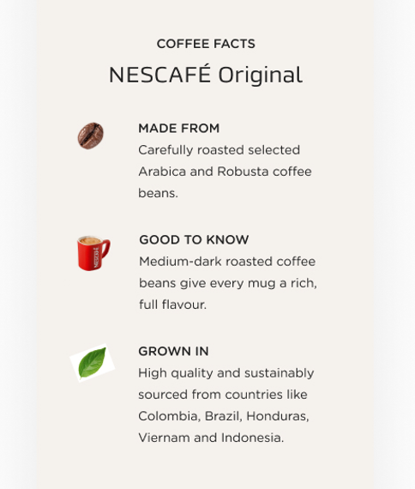
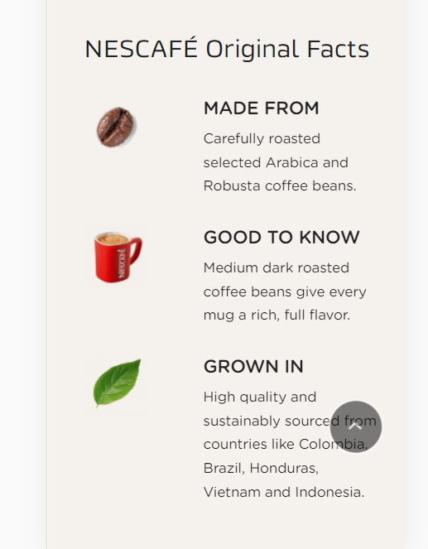
design
UAT
Bigger icons – leads to less space for text in mobile

Slide 20
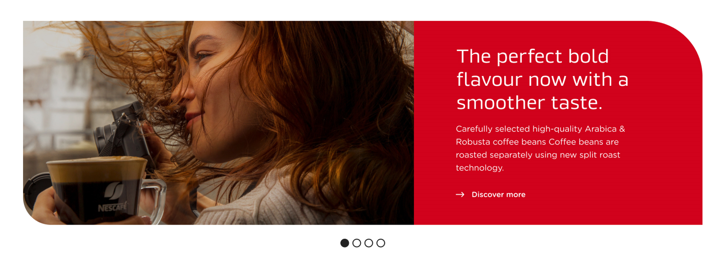
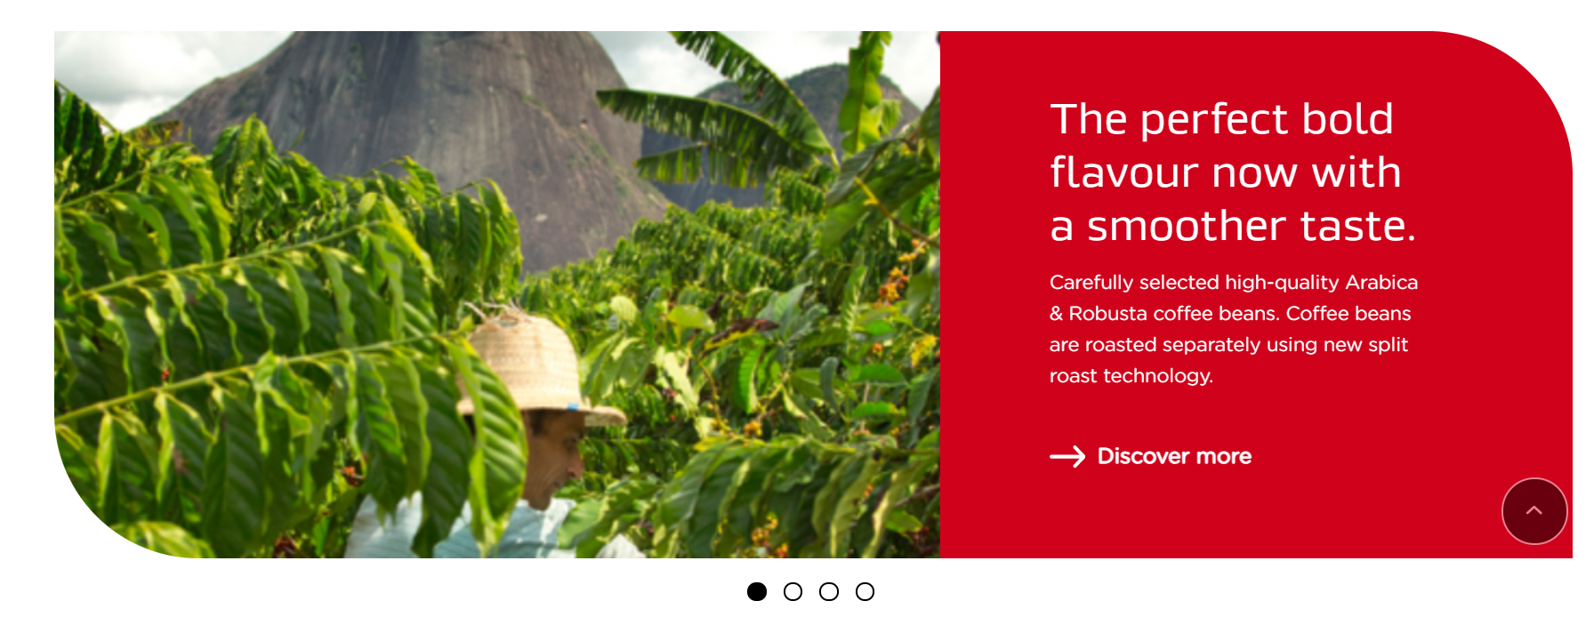
design
UAT
The module is higher and the photo bigger – has to be like this?

Slide 21
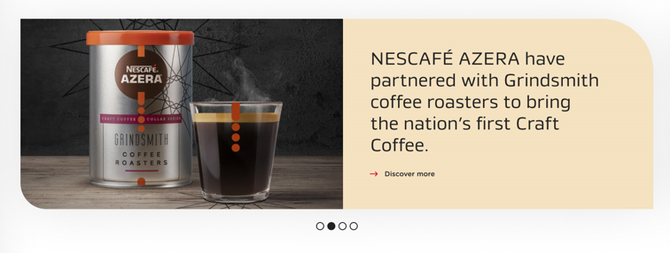
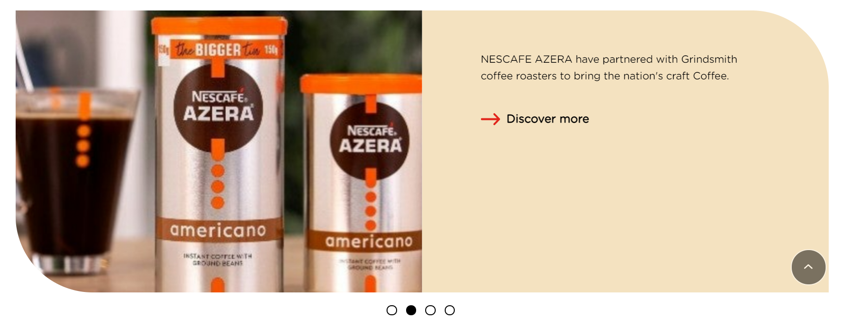
design
UAT
Header has a diferente size – is that a reco?

Slide 22


design
UAT
Image bigger and text module smaller – the header does not look ok like this. Can we expand the text module?

Slide 23
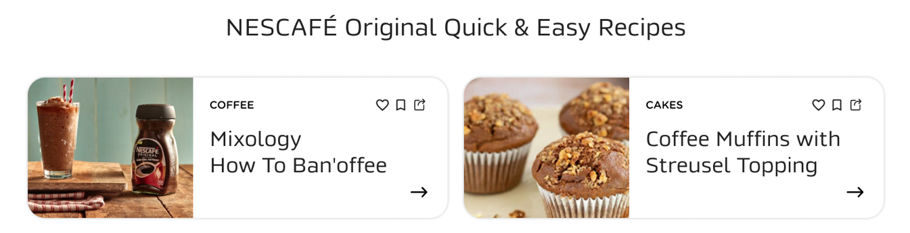
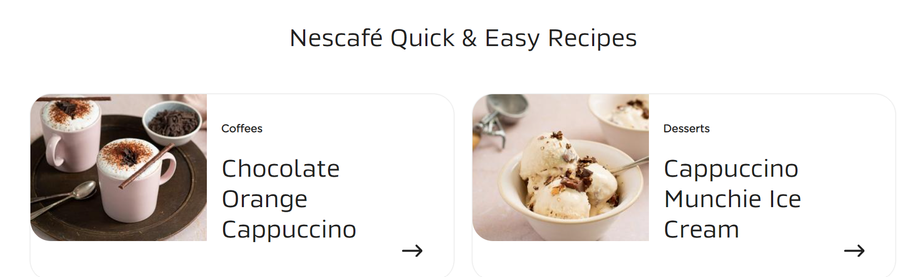
design
UAT
Please try to follow the design approach and have the recipes name in 2 lines only

Slide 24
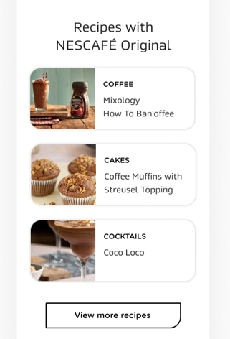
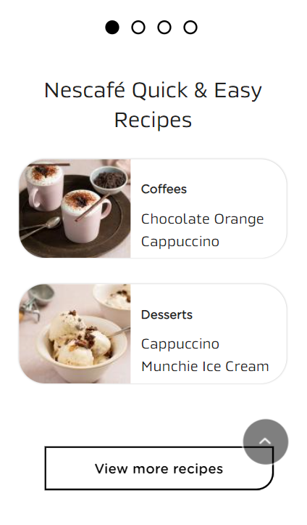
design
UAT
3 versus 2 récipes? The texto not centered.
There is no call to action/ arrow in mobile for each recipe

Slide 25
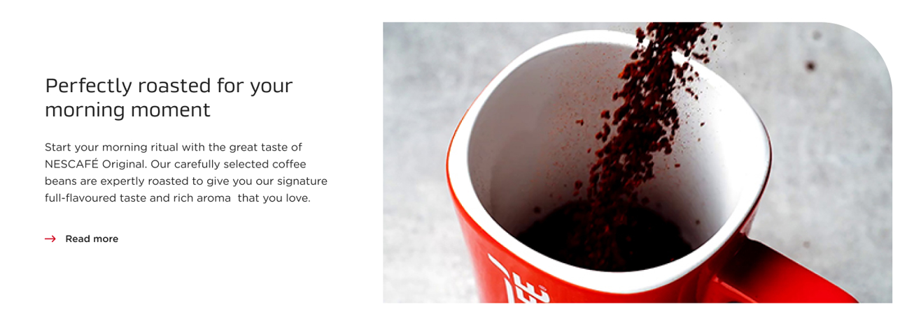
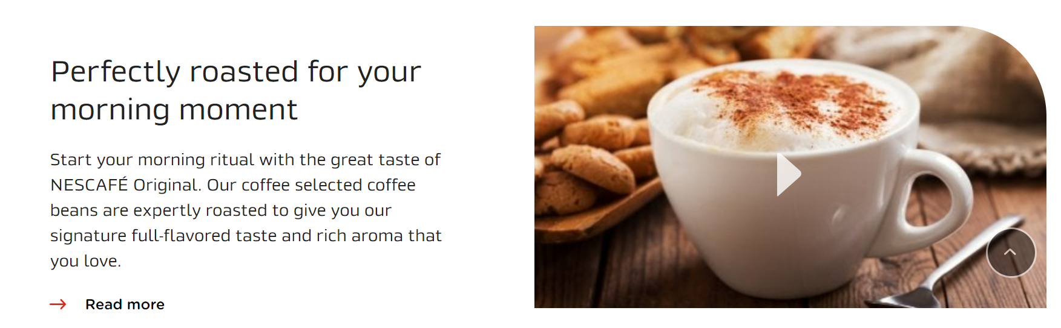
design
UAT

Slide 26


design
Logo seems to be
UAT

Slide 27
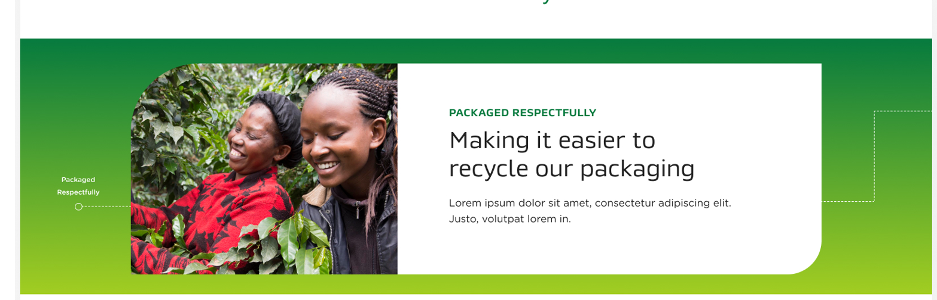

design
UAT
Misses the lines and texto in the green part and the texto looks more packed

Slide 28

The image and texto box look lost in the green in desktop – look streched
UAT

Slide 29
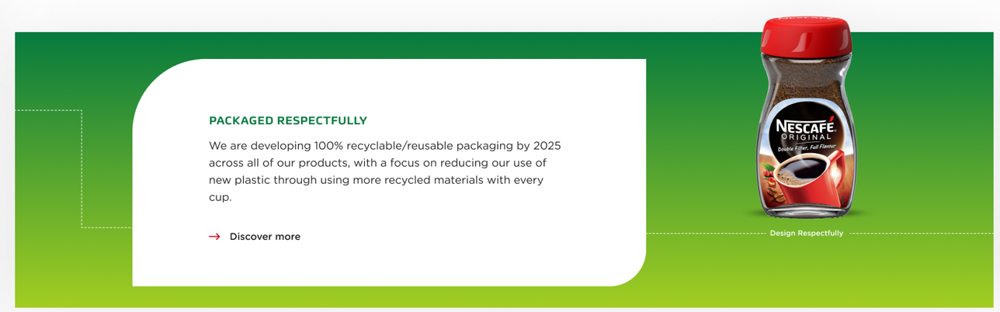
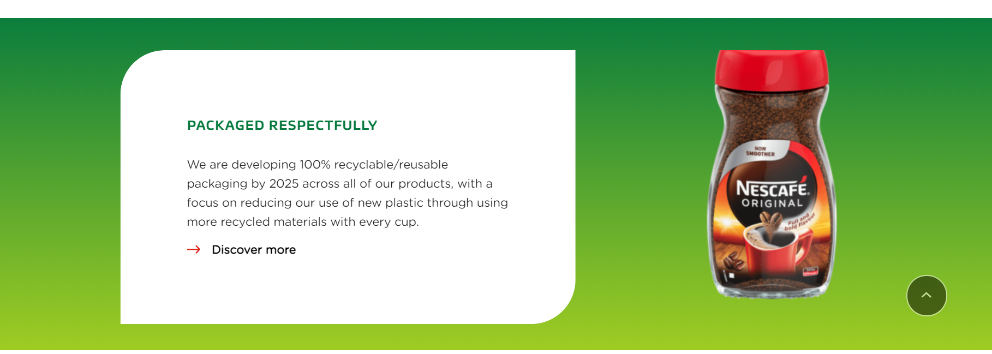
design
Misses the lines and text in the green part
UAT

Slide 30
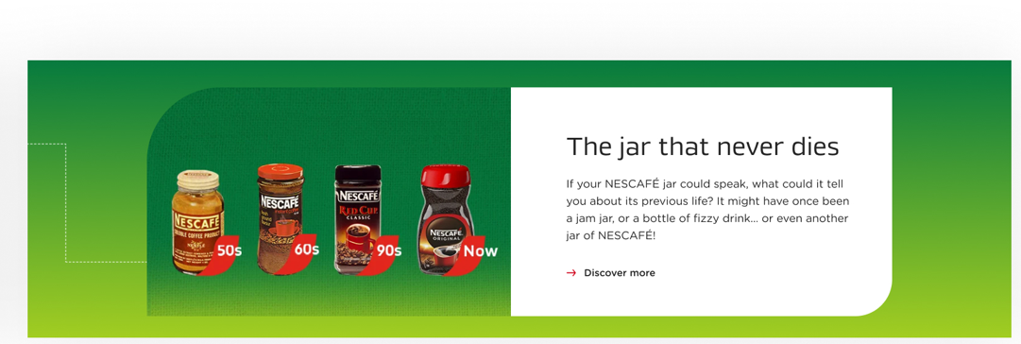
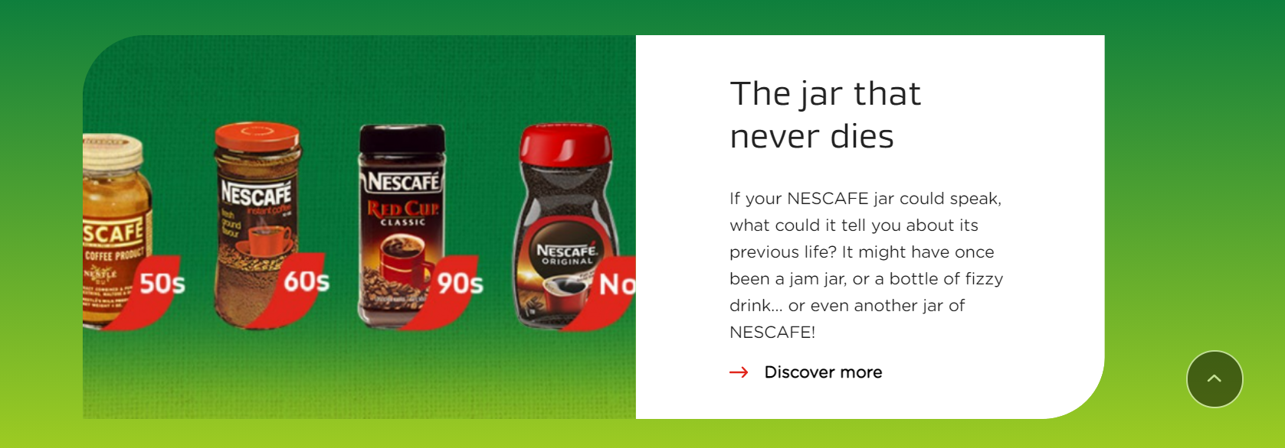
design
Misses the lines in the green part and the texto looks packed
UAT

Slide 31
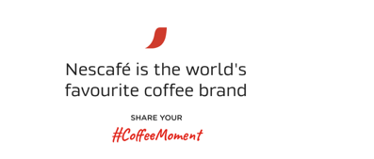
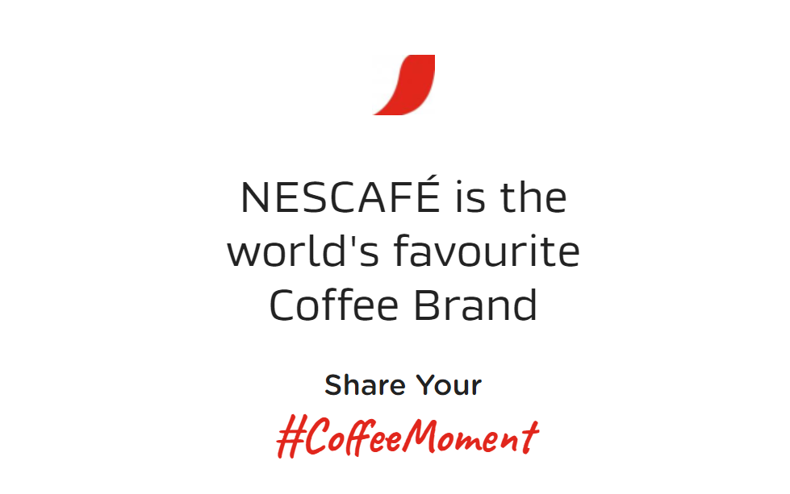
design
UAT
Aligen with the deisgn – 2 lines – “share your in caps”

Slide 32
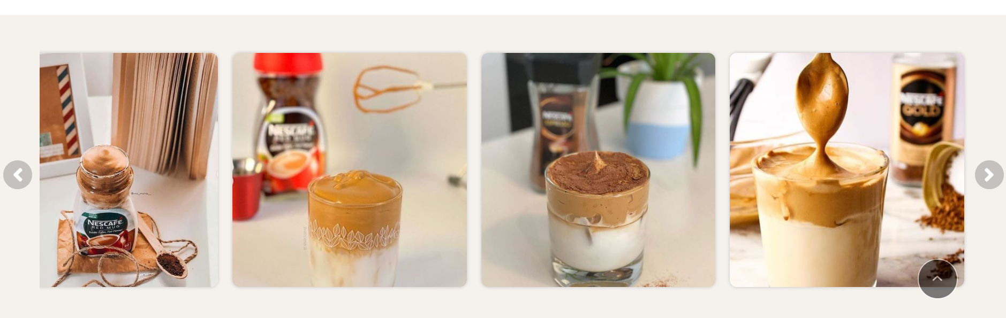
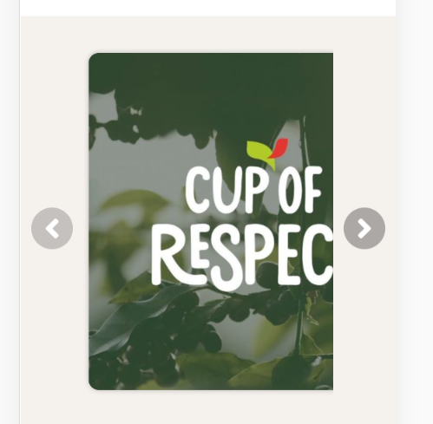
Is the TINT module with a TINT galery already implemented? Or is this a paceholder?
In mobile is not ok.

